Slide 1
Reducing the Massive Energy Appetite of Data Centers
Presenter: Dennis Zang

Slide 2
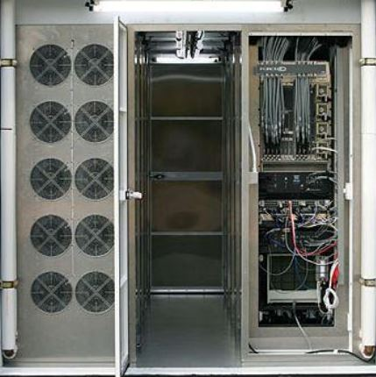
What is a Data Center?
-Basically a building what houses database servers
-database server: a computer that specializes in storing, retrieving, and computing with the information in its memory
-necessary functions:
-serve multiple clients 24/7
-must read/access data quickly

Slide 3
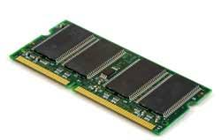
Energy Consumption
-limitations of data centers:
-needs constant cooling
-prevent thermal noise, leakage currents in semiconductors, transistor failure, etc…
-40% of power goes toward cooling
-needs constant power supply
-have the CPUs and memory active all the time

Slide 4
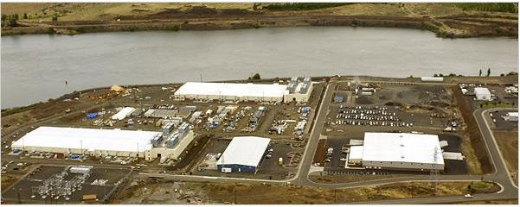
Energy Consumption
-2% of the United States’ total power goes toward powering data centers
-Total: 91 billion kWh (in 2015)
-all goes towards 3 million data centers (12 million computer servers)
-Costs:
-Total: $9.48 billion (in 2015)
-(per data center) at least $3000 annually

Slide 5
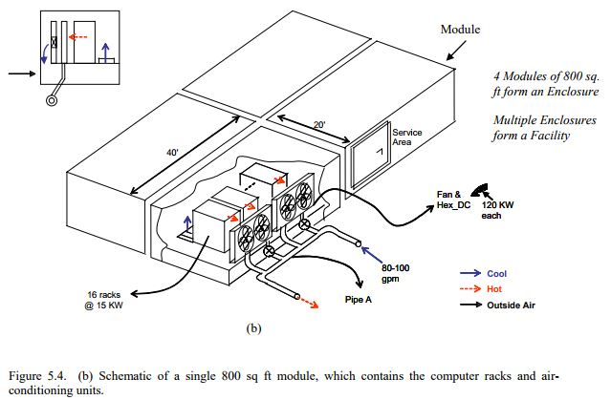
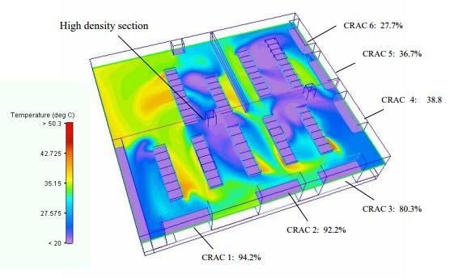
Solution 1: Improve Cooling System
-typically some implementation using air conditioning/cycling, heat sinks, and evaporator coils
-factors of consideration: location, local climate, building design, etc…
-deals with fluid dynamics and civil engineering

Slide 6
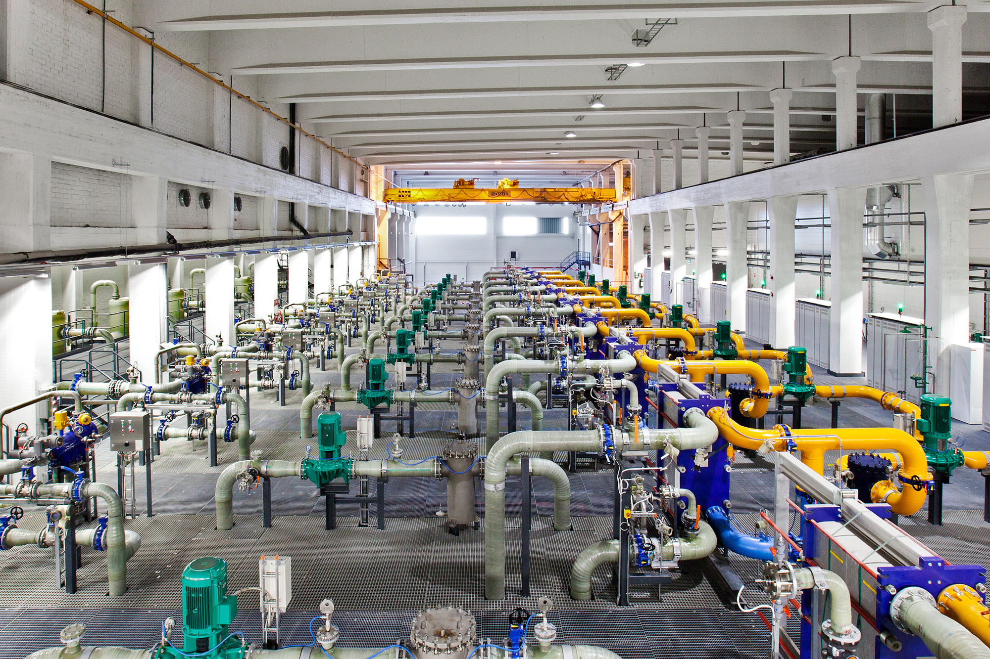
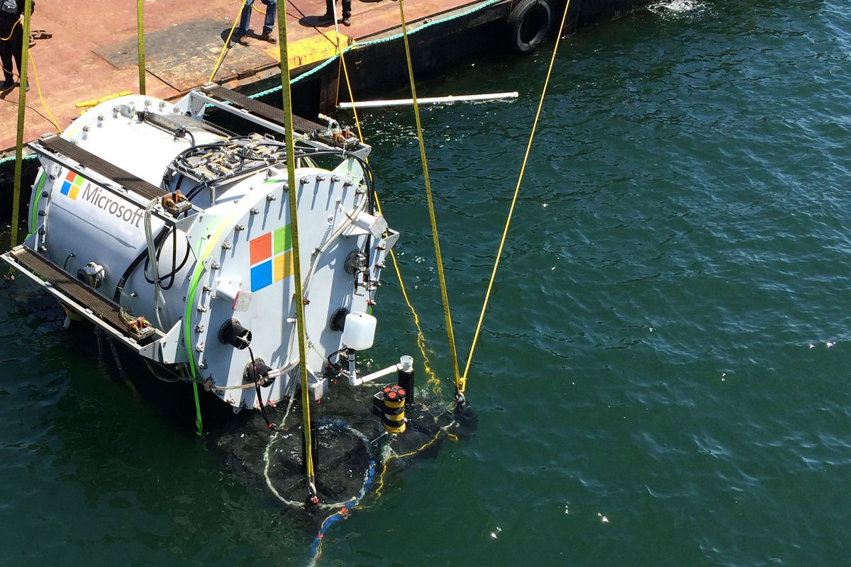
sssss
Microsoft’s project of building underwater data centers.
Google’s use of seawater from the Gulf of Mexico to cool one of its data centers.

Slide 7
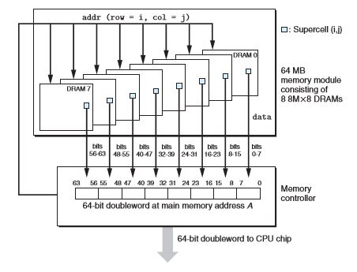
Solution 2: Solid-State Drives
-for good performance, effective caching is needed
-sometimes, all the data is stored in main memory (“in-memory database”)
-DRAM: dynamic random-access memory (typically for main memory)
-generally, avoid cache misses, otherwise penalty towards performance

Slide 8
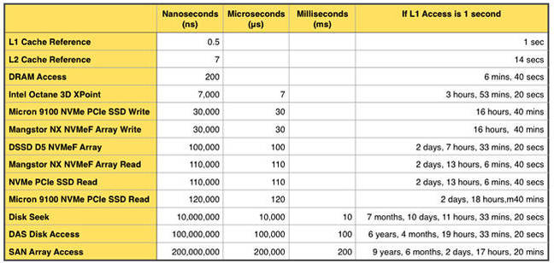

Slide 9
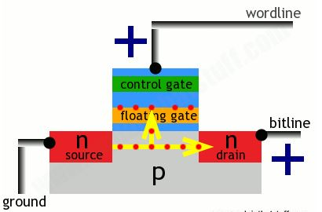
Solution 2: Solid-State Drives
-solution: use combination of flash memory and DRAM
-known as BlueCache
-brought up by MIT researchers in 2015
-claimed to be viably competitive with DRAM
-flash memory advantages:
-uses on 5% the power of DRAM
-cost about 1/10
-100 times storage density

Slide 10
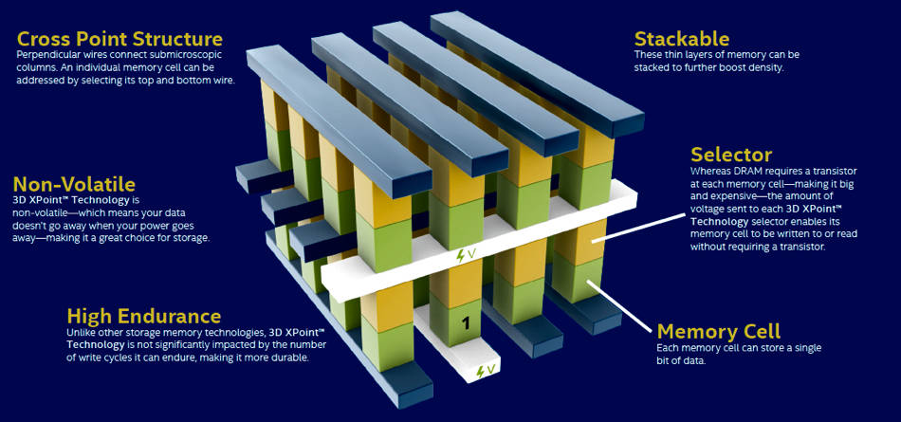
Solution 2: Solid-State Drives
-another solution: Micron’s 3D XPoint
-faster alternative to HDD
-Phase Change Memory material
-slower than DRAM, but faster than flash memory
-basically, a new form of SSD

Slide 11
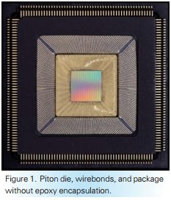
Solution 3: Efficient CPUs
-individually, the CPUs for each server in the data center is responsible for most of the power consumption
-example: Piton microchip
-25-core processor developed by Princeton researchers
-executes multiple instances of the same command in parallel
-20% more energy efficient

Slide 12
Sources
Arvind, et al. “BlueCache: A Scalable Distributed Flash-based Key-value Store”. 2016.
http://www.vldb.org/pvldb/vol10/p301-xu.pdf.
Barroso, Luiz André, et al. The Datacenter as a Computer: An Introduction to the Design of
Warehouse-Scale Machines. Morgan & Claypool Publishers, vol. 2, 2013.
http://www.morganclaypool.com/doi/pdf/10.2200/S00516ED2V01Y201306CAC024.
Choi, Charles Q. “Reducing the Massive Energy Appetite of Data Centers.” Inside Science, 18 Sept. 2017, www.insidescience.org/news/reducing-massive-energy-appetite-data-centers.
Dean, Jeff. “Challenges in Building Large-Scale Information Retrieval Systems”.
https://static.googleusercontent.com/media/research.google.com/en//people/jeff/WSDM09-keynote.pdf.

Slide 13
Delforge, Pierre. “New Study: America's Data Centers Consuming -- and Wasting – Growing
Amounts of Energy.” NRDC, 15 Dec. 2016, www.nrdc.org/experts/pierre-delforge/new-study-americas-data-centers-consuming-and-wasting-growing-amounts-energy.
“Intel and Micron Increase 3D XPoint Manufacturing Capacity with IM Flash Fab
Expansion.”Intel Newsroom, 13 Nov. 2017, newsroom.intel.com/news/intel-micron-expand-3d-xpoint-manufacturing-capacity-im-flash-fab-expansion/.
Mellor 21 Apr 2016 at 08:58 tweet_btn(), Chris. “Storage with the Speed of Memory? XPoint,
XPoint, That's Our Plan.” The Register® - Biting the Hand That Feeds IT, 21 Apr. 2016, www.theregister.co.uk/2016/04/21/storage_approaches_memory_speed_with_xpoint_and_storageclass_memory/.
Patel ,D. Chandrakant and Amip J. ShahCost. “Model for Planning, Development and Operation
of a Data Center”. Hewlett-Packard Development Company, L.P. 2005. http://www.hpl.hp.com/techreports/2005/HPL-2005-107R1.pdf.
“U.S. Energy Information Administration - EIA - Independent Statistics and Analysis.” State
Electricity Profiles - Energy Information Administration, U.S. Energy Information Association, 17 Jan. 2017, www.eia.gov/electricity/state/.

